Slide 1
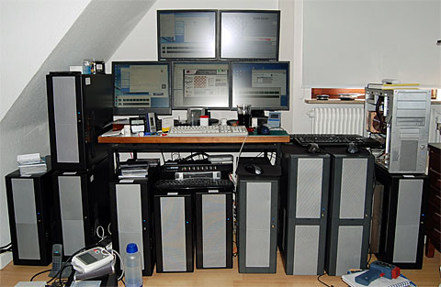
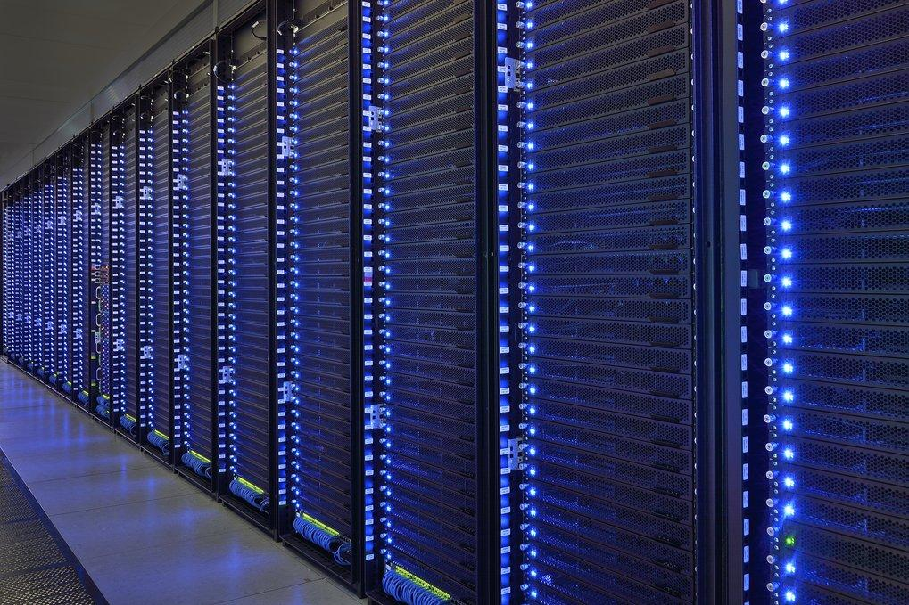
An Introduction to
Cluster
and
High Throughput
Computing
How to make the most from your resources

Slide 2
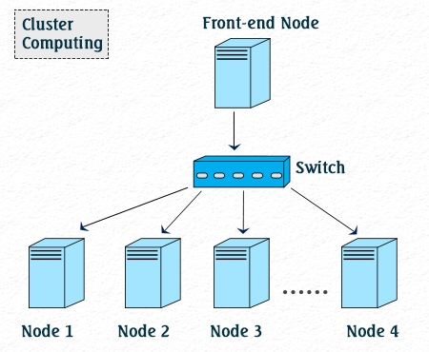
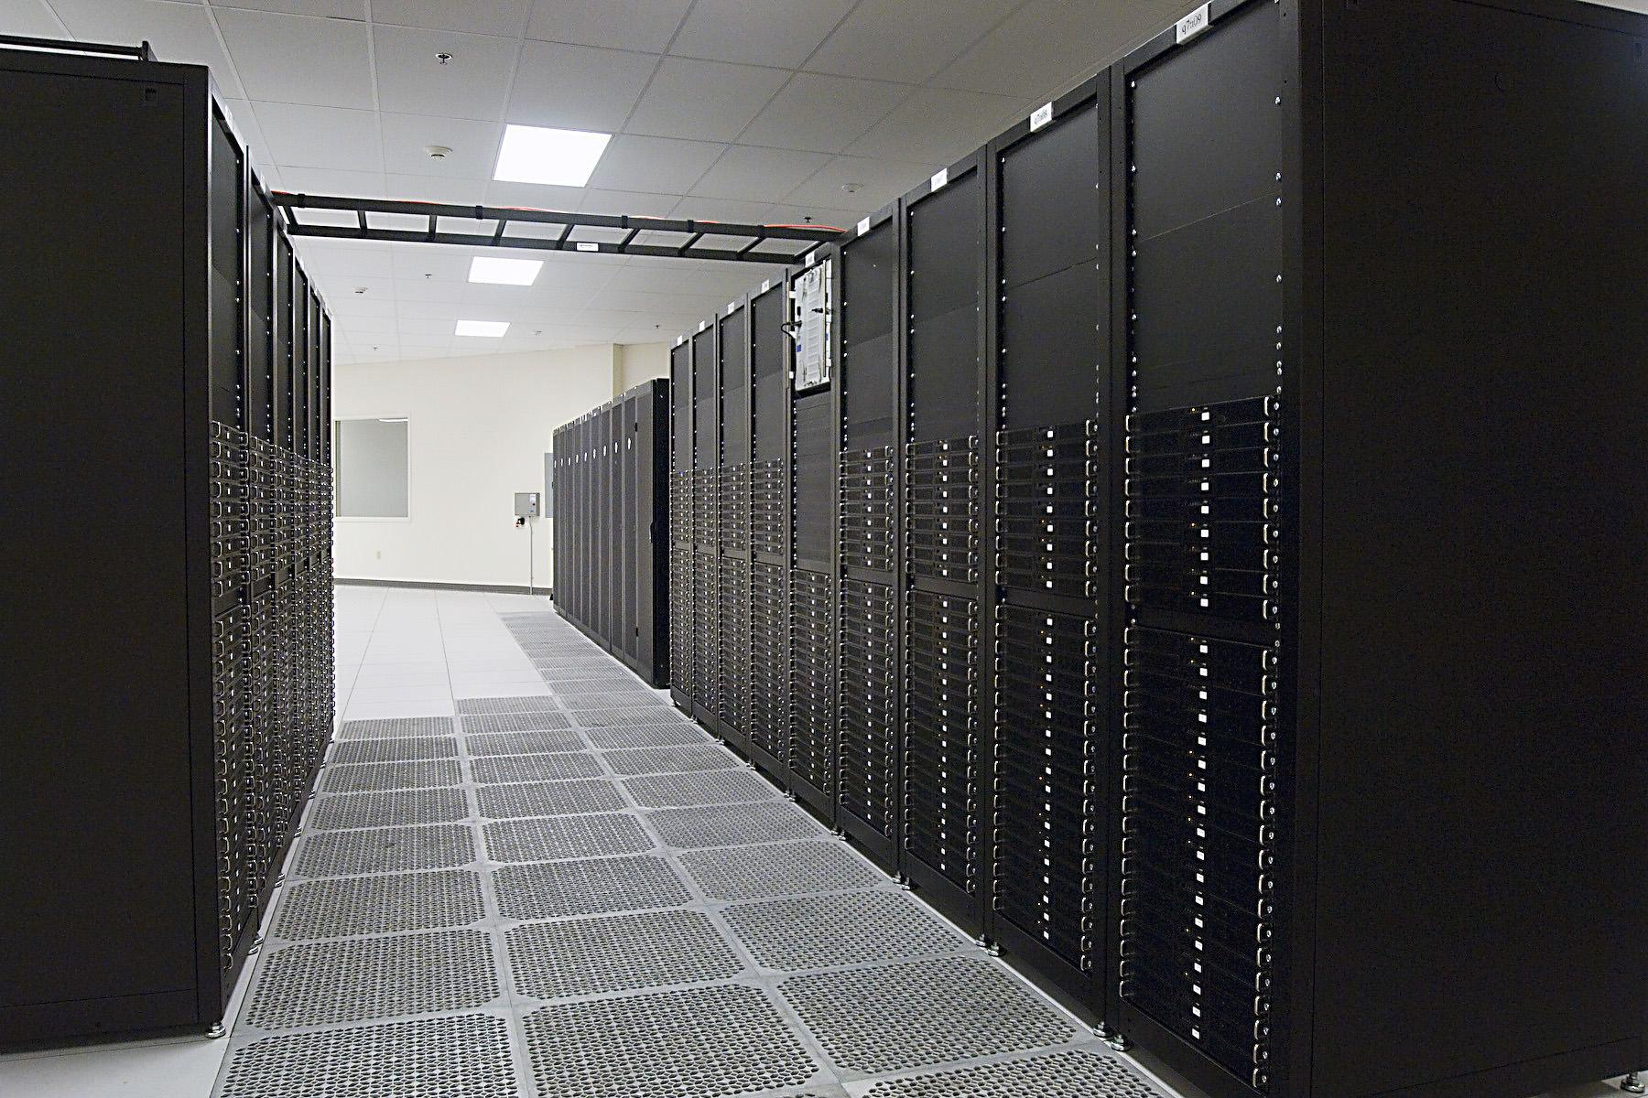
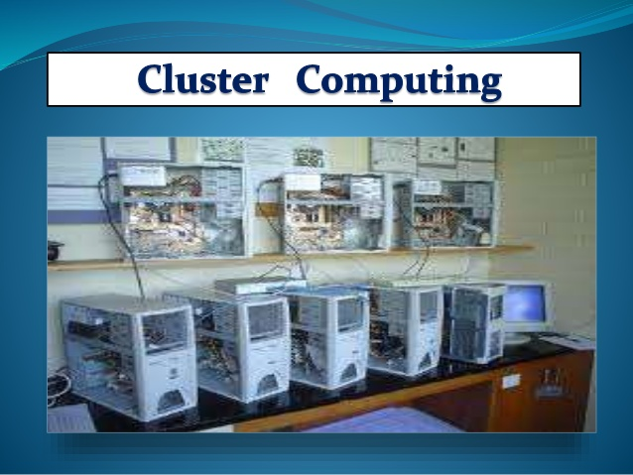
Outline
A little about me
A Brief Discussion of Cluster Computing
HEP computing in the past
HEP computing in the present
Something fun with clusters

Slide 3

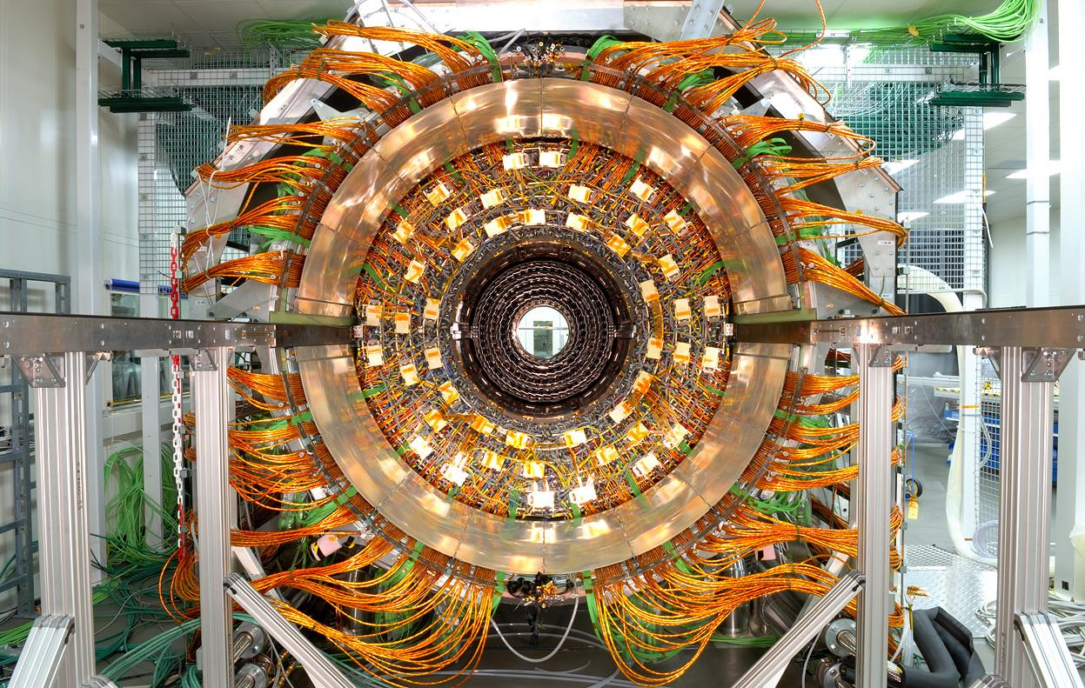

Who I am
Douglas Johnson: Born in South Carolina, USA
Raised in New Jersey
BS 1981 Rutgers, The State University of New Jersey
PhD 1990, The Ohio State University
Postdoctoral Research
Research Associate
Senior Research Associate
1990 to present
The University of Colorado
Boulder Colorado

Slide 4


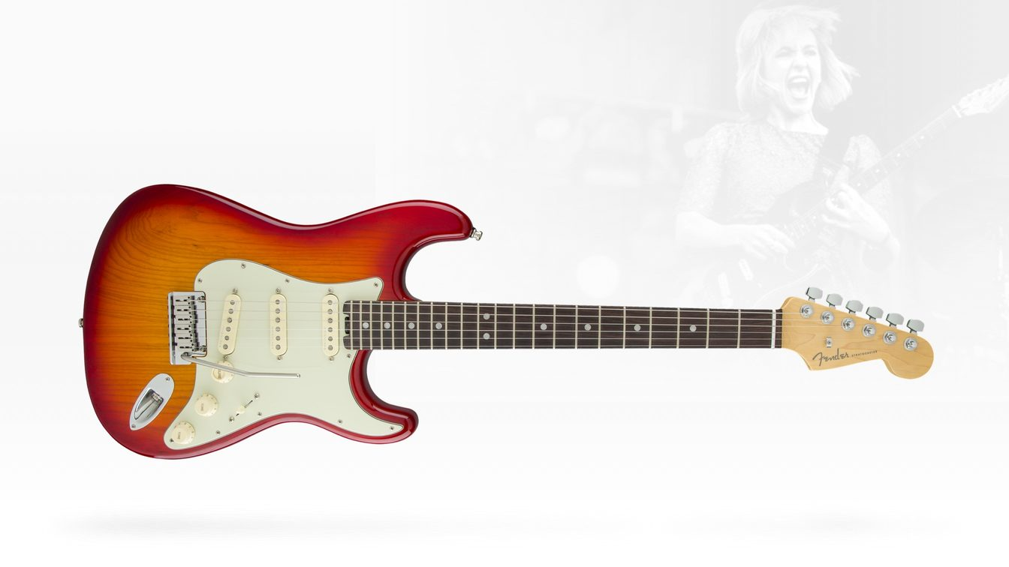
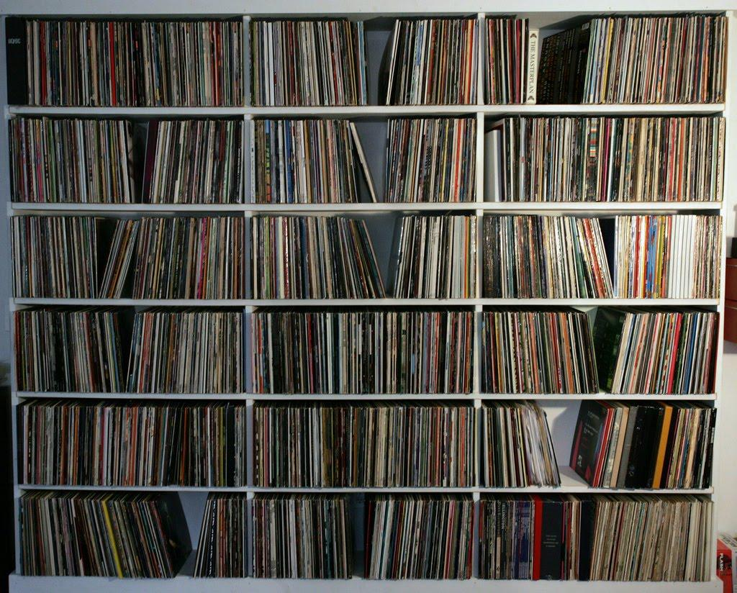
Who I am
Other interests: Road cyclist racer - 25 years
Music - Trumpet and guitar - Too many years
Record collector - They are everywhere in the house
Wood working
Home repair
Reading computer documentation - What a nerd!!!
Almost everything computer - No social media!!!

Slide 5



Computing Cluster
Definition: A computer cluster is a set of loosely or tightly connected computers that work together so that, in many respects, they can be viewed as a single system
Basic components of computing cluster
Usually:
Fast local network
All computers are similar or same hardware
All computers run same operating system (Version and distribution)
Distributed file system
No monitors
Private network
Outbound Internet access
No inbound Internet access
Hardware generally chosen by highest performance to cost ratio
Jobs managed and queued by batch system (Condor, PBS, SLURM)
Middleware software to manage computer configuration (Puppet)
Middleware software to install operating systems (Cobbler)
Important concepts: Configuration management and provisioning

Slide 6
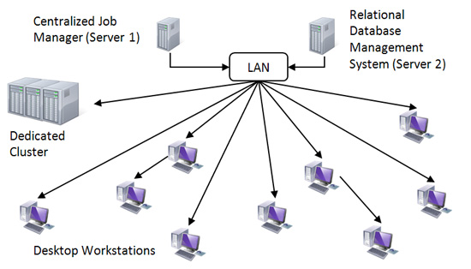
Computing Clusters

Slide 7

Job Management
Functionality of the Batch System
A job is a program that a user wants to run on the cluster
Typical cluster will have many jobs and many users
Want to manage the running of jobs to:
Efficiently use the system
Give user their fair share of the resources
Sometimes users have different priority on the system:
Run shorter jobs sooner
Longer job is in the queue the higher the priority
Jobs may require different resources:
High memory
Multiple cores
Multiple nodes
Fast disk I/O
May want to limit run time
May need to remove jobs that exceed resource usage

Slide 8
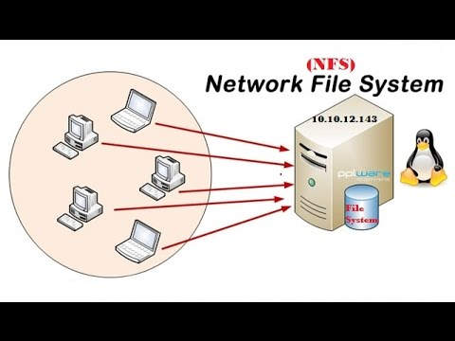
Network File Systems
A file system which is shared by being simultaneously accessible on multiple computers
Required:
Unique user names or file owners
Unique file identification:
Two unique files:
/etc/ntp.conf
/var/ntp.conf
Desired:
Every computers sees identical file system structure
One of the earliest network filesystems was NFS
Written in the 1980s
Still used today
The NFS server is a single point of failure
The NFS server is a throughput bottle neck
NFS does not scale well with many I/O transactions
NFS does do many things correctly
NFS goes to great lengths to prevent file loss

Slide 9

Distributed file system
Very similar to network file system except files are stored on multiple servers
May add redundancy for file loss protect
May add replication for higher performance
May be distributed over LAN and/or WAN
May be accessible over LAN and/or WAN
Goal is usually high performance and resiliency (reliability)
Examples:
HDFS - Hadoop file system
Designed by Yahoo and Apache
Divides files into blocks and stores different blocks on different machine
Uses file replication for resiliency
Very good for large files (>1GB)
Very poor for small files
Very fast concurrent reads and combined I/O
GFS - Google file system
Specifications are a trade secret
CVMFS
Written by CERN (Geneva Switzland)
Readonly on WAN
Accessible worldwide
Different file systems have different features
No one file system is the best file system
Different file systems address different issues
Choose what it is best for you

Slide 10
Types of Computing Clusters
High Throughput:
Less concerned about the performance of any single node
Focused on the combined performance of the system
Efficiently run many jobs usually by many users
Throughput can be:
Number of jobs
Amount of data read
Amount of date written
High performance:
More emphasis on performance of each node
And how each node can interact to act like a single very fast computer
Generally very fast (>100Gb) very low latency (<1 msec) network
Parallel computing:
MPI (Message passing interface) within a node and across nodes
GPUs - Often GPU clusters
These are often constructed of lots of lower cost components
Rarely have the high performance networks
Rarely benefit from program parallelization
Often benefit from data processing parallelization
These are often what we call supercomputers.

Slide 11
Some of Topics we will cover related to HTC
Linux installation:
This is known as “provisioning”
Initial installation with a USB stick
Network installation using PXEBOOT server (Cobbler)
Linux configuration and management
This is known at “configuration management”
Inital system from interaction command line
Network installed machines using remote softwore (Puppet)
Batch systems
Condor
SLURM if time permits
Virtual machines
Linux Containers
File Systems
Local file systems
Distributed file systems
Practical applications and uses for HTC
Many other topics - I will have a more complete list by next week

Slide 12
First Summary
High throughput computing addresses the issue of getting as much “stuff” through the system as fast as possible.
What is this stuff?
For example:
Google processes lots of web pages
Facebook processes lots social media information - your personal information
Governments process lots of surveillance data
Scientists process lots of experimental data
Film industry generates lots of computer generated graphics
I am a member of the physics called the Compact Muon Solenoid
The raw data rate is 40 TB/s!!!
Only 1 part if 10 million is worth recording
The recorded data rate is 1 GB/s
In other words, about 31 PB/year
High throughput computing is used to process all of these data

Slide 13
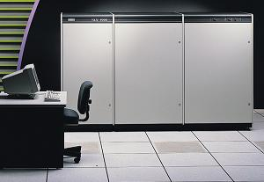
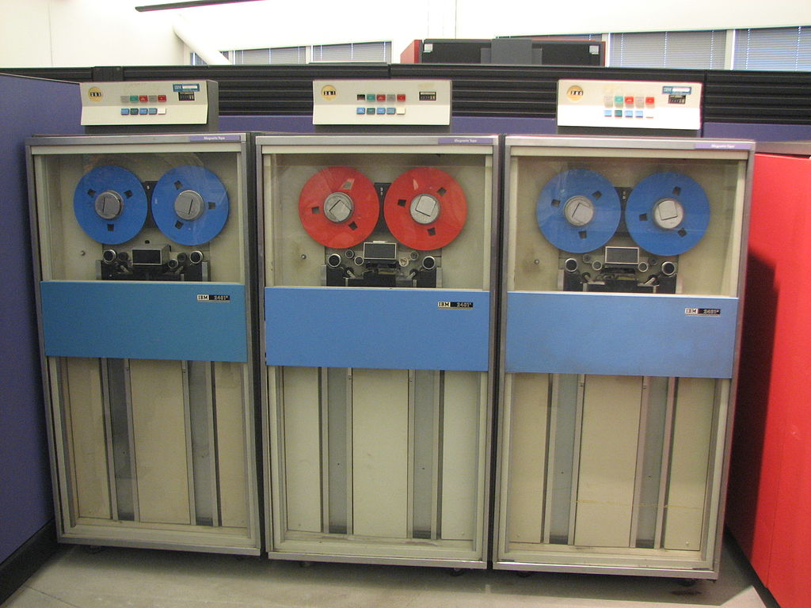
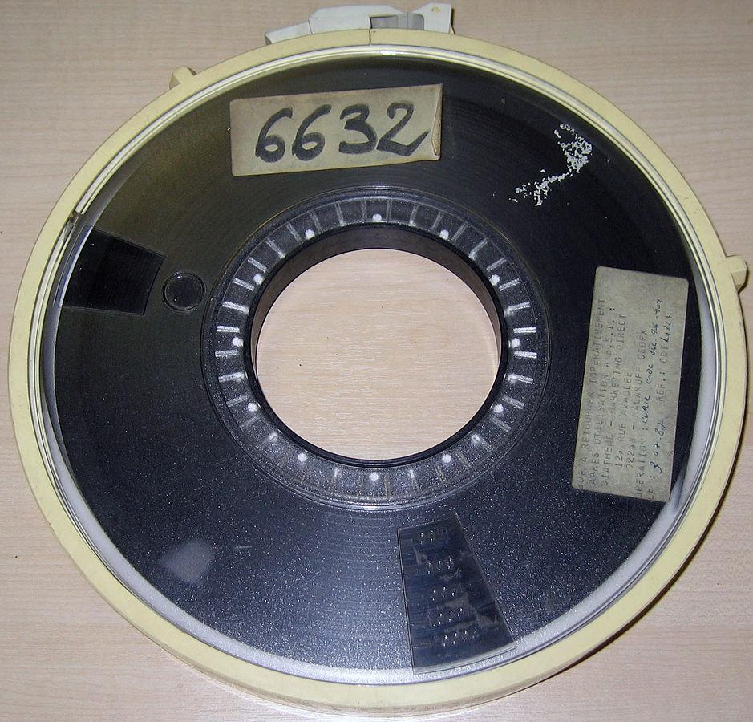
Early example of High Throughput Computing
9 Track Magnetic Tapes: Capacities of 22.5MB, 45MB and 175MB. PhD thesis data: 21 9-track tapes
Approximately 1GB of data
It took over 24 hours of computing time to read 21 tapes
Analysis ran on VAX 8800
Computer cost was over $500,000 in 1990 (>$1M 2018)
Today my thesis data on USB stick and process in about 15 minutes
But at the time this was High Throughput Computing!

Slide 14
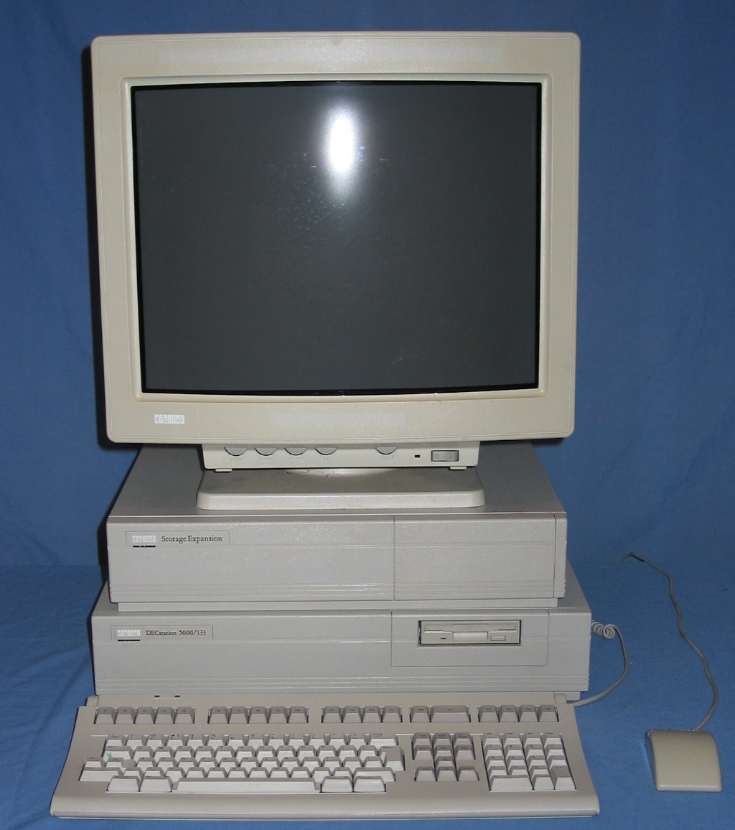
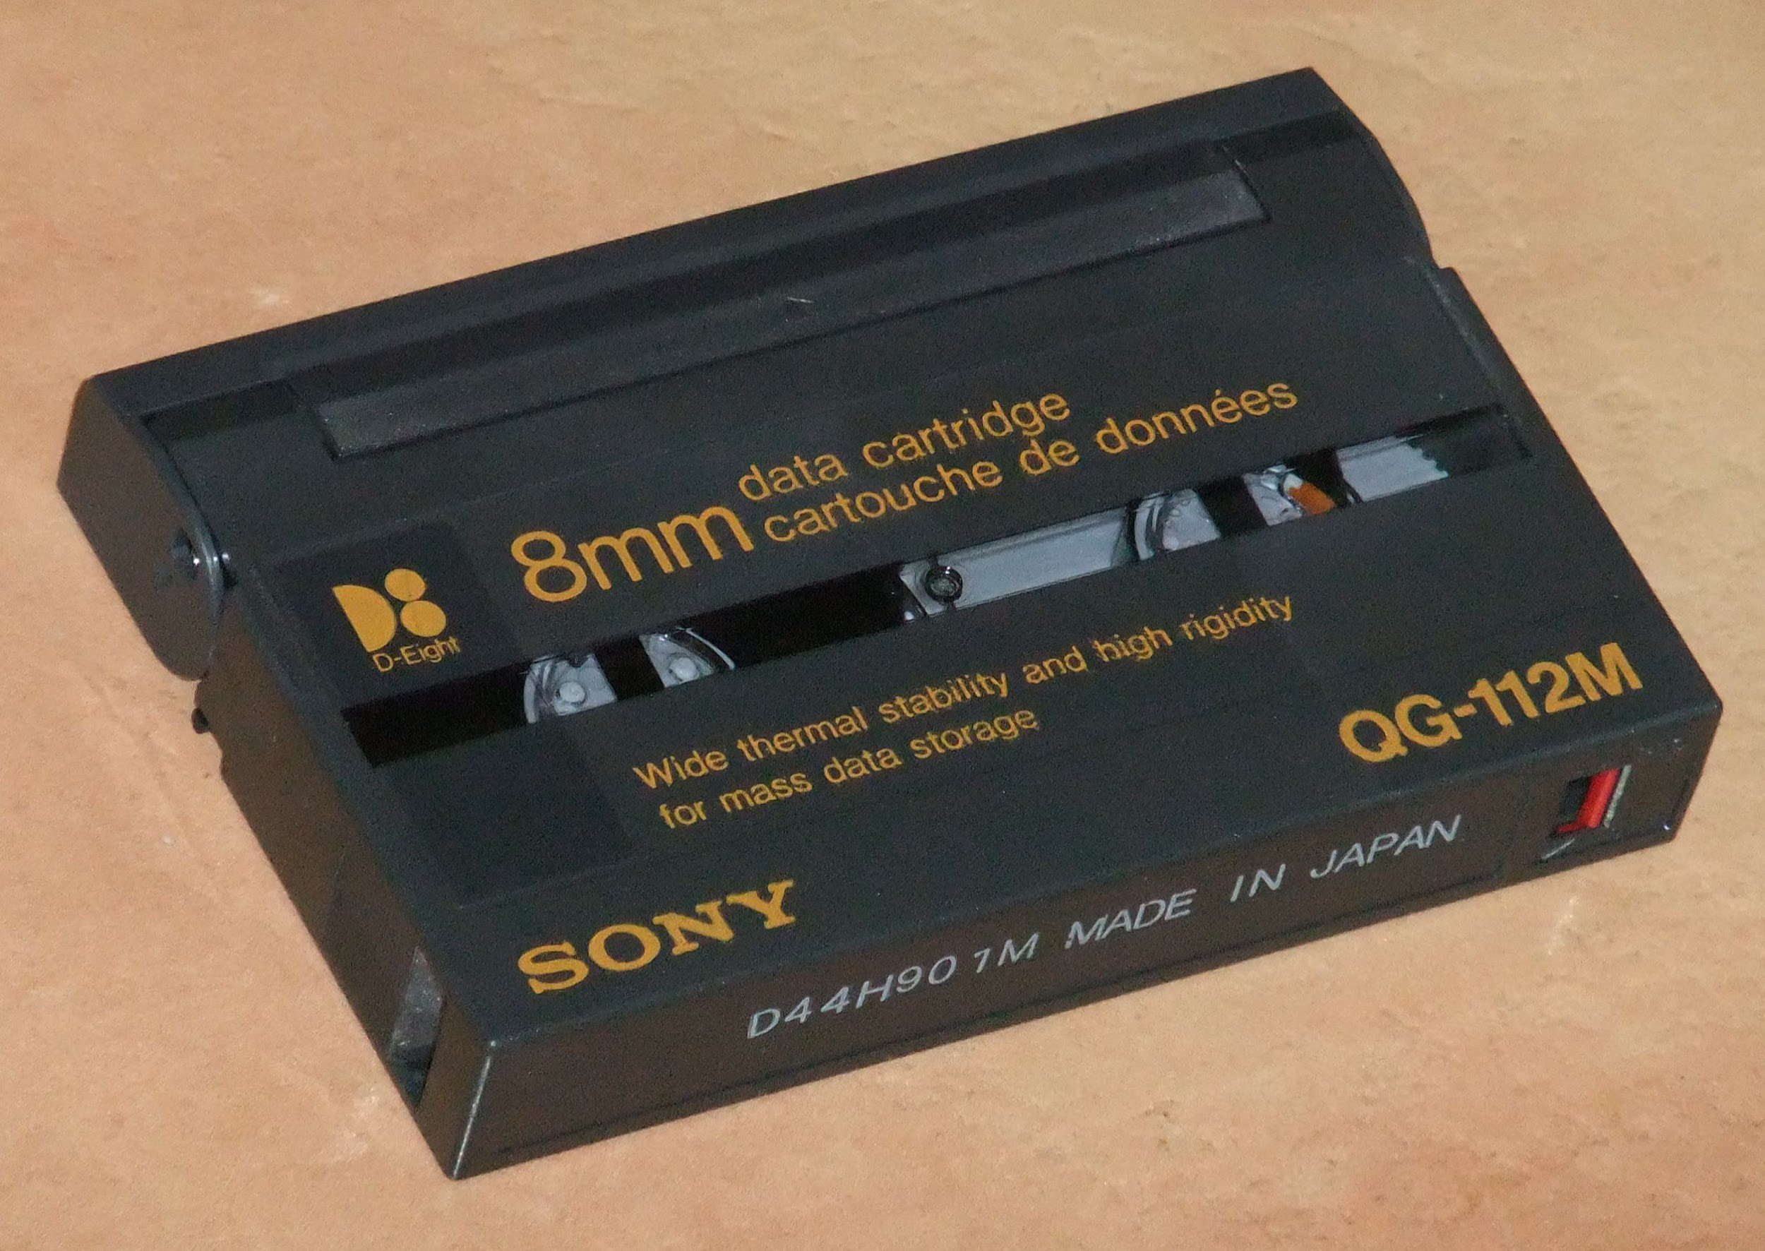
In the early 90’s, we started to move to distributed computing.
At the University of Colorado:
We built our first distributed computing from a collection of desktop Digital Dec Stations
Used a version Unix from Digital Corporation (no longer in business)
Network connection was 10Mb coaxial cable (Single broadcast domain)
If you disconnected a network cable anywhere on the network, the entire network would go down!
We stored data on “large” 2 - 4 GB disk drives and 8mm tapes.
Tape capacity was “huge” 40 GB.
We starting using a batch queue system to schedule jobs.
Since these machines sat on people’s desks, we had to suspend batch jobs during work hours.
Cost of desktop
About $20,000

Slide 15
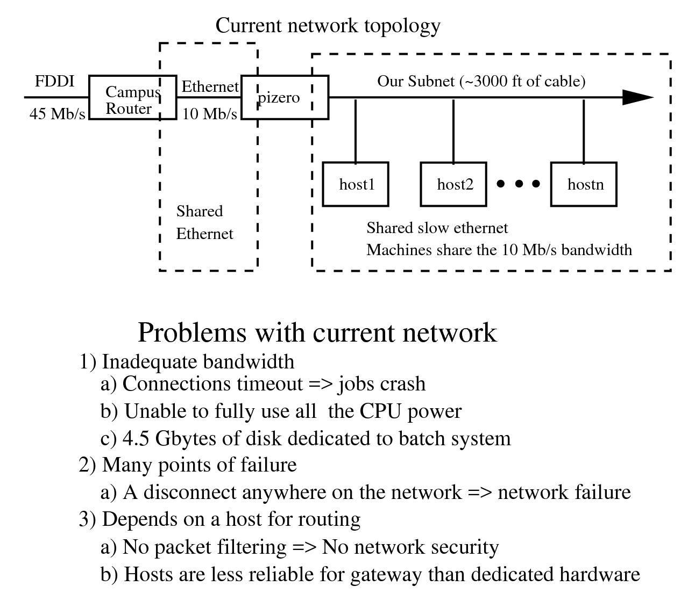
Network diagram circa 1996

Slide 16
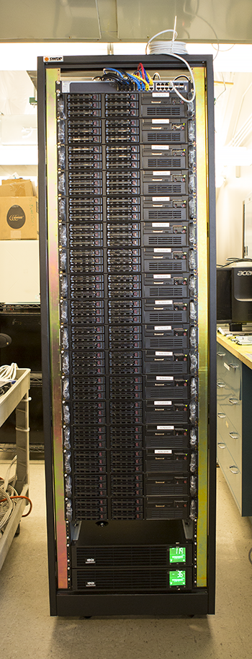
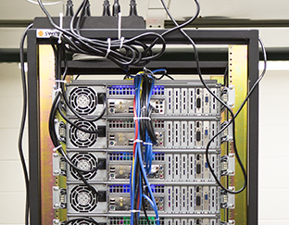
New Rack assembled Dec 2017
15 nodes
64 GB RAM/node
240 cores
180 TB Hadoop disk space
Approximately 4000 HEPSPEC06
Built completely in house from off the shelf components

Slide 17
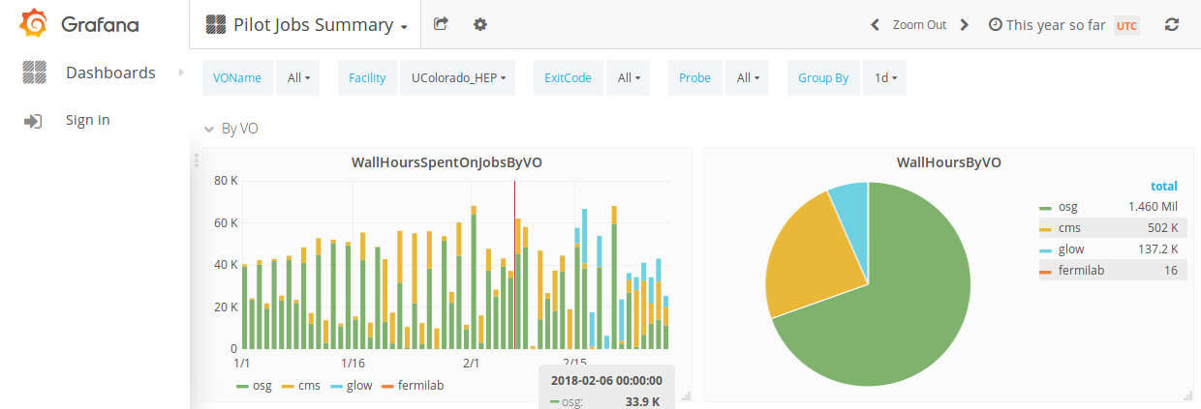
Cluster at University of Colorado
About 200 compute nodes
About 1700 cores (batch slots)
1.4 PB of Hadoop data storage
500 TB of NFS data storage
About 20 support servers
10 Gb Internet connection
Mix of 10Gb and 1Gb in computer room
In 2017, the cluster ran for about 10 Million CPU hours
2018 (Jan 1 - today) - 1.6 Million CPU hours

Slide 18
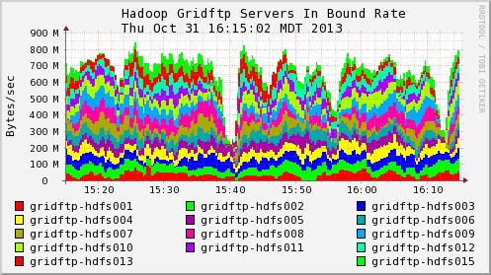
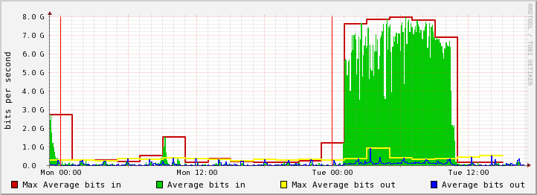
Network Performance at the University of Colorado
Internally transferring data at about 700 MB/s
Externally transferring data at about 7Gb/s

Slide 19
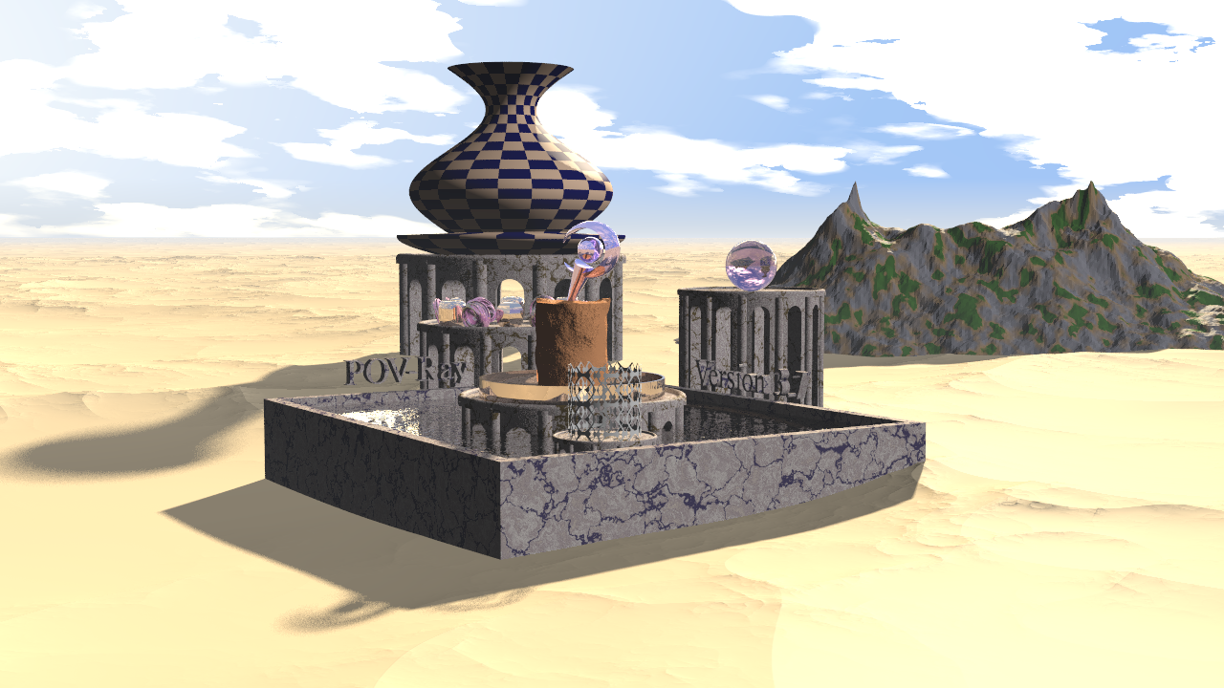
Something fun with HTC
The Persistence of Vision Ray Tracer is a program that generates realistic computer images
The image below takes about 3 minutes to generate on a Core i7 with 16 cores 64 GB RAM
A movie is just a series of images
To make a 2 minute move at 30 images per second would require more than one week on a single machine
If I divided the task up and use 100 machines, I can generate the same movie in about 2 hours.

Slide 20
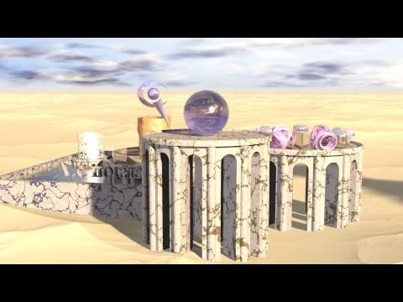
This is also High Throughput Computing

